Slide 1
Object Oriented Programming Lecture-7
Input and Output: Byte Stream vs Character Stream, Command Line arguments, use of Scanner Class
Prof. Varsha Dange

Slide 2
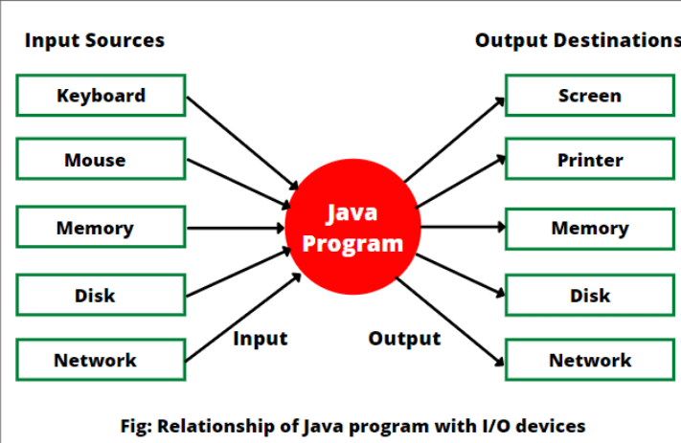
Java IO
Java IO (Input and Output) is a process of reading data from a source and writing text data to a destination.

Slide 3
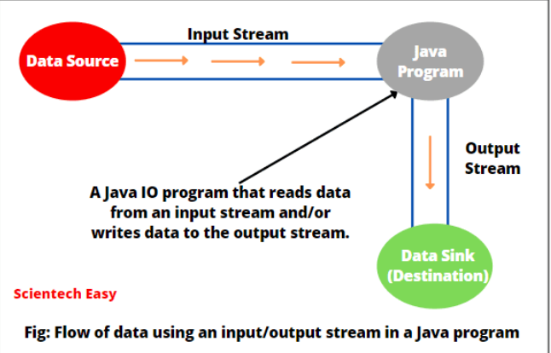
Stream in Java
in Java ,Stream represents sequential flow (or unbroken flow) of data from one place to another place.
Stream in Java represent an ordered sequence of data.
Java performs input and output operations in the terms of streams.
It is required to accept data as input from the keyboard. The data in the form of stream may be bytes, characters, objects, etc.

Slide 4
Standard Stream
In Java, 3 streams are created for us automatically.
All these streams are attached with the console.
System.in –read from KB
System.out-display data on console
System.err-display error messages
import java.lang.*;
java.lang

Slide 5
IO Stream in Java
Modern versions of Java platform define two types of I/O streams:
Byte streams
Character streams

Slide 6
Byte Stream
Byte streams in Java are designed for handling the input and output of bytes (i.e., units of 8-bits data).
They are used for reading or writing to binary data I/O.
They are used when we are working with binary files - executable files, image files, and files in low-level file formats such as .zip, .class, .obj, and .exe file.
Binary files are those files that are machine-readable.
Byte streams that are used for reading are called input streams and for writing are called output streams.
They are represented by the abstract classes of InputStream and OutputStream classes in Java.

Slide 7
Character Stream
Character streams in Java are designed for handling the input and output of characters. They use 16-bit Unicode characters.
They are mainly used for reading or writing to character or text-based I/O such as text files, XML, and HTML files.
These files are human-readable.
Character streams that are used for reading are called readers and for writing are called writers.
They are represented by the abstract classes of Reader and Writer class in Java.

Slide 8


Streams /IO Hierarchy
Stream
Byte Stream
Char Stream
Input Stream
Output Stream
Reader
Writer
Read ()
Write ()

Slide 9
Byte Stream vs Character Stream
Byte Stream | Char Stream
Reads data byte by byte | Read data character by character
Used for inputting and outputting the bytes | Used for inputting and outputting the characters
Two classes :InputStream and OutputStream | Two classes :Reader and Writer

Slide 10
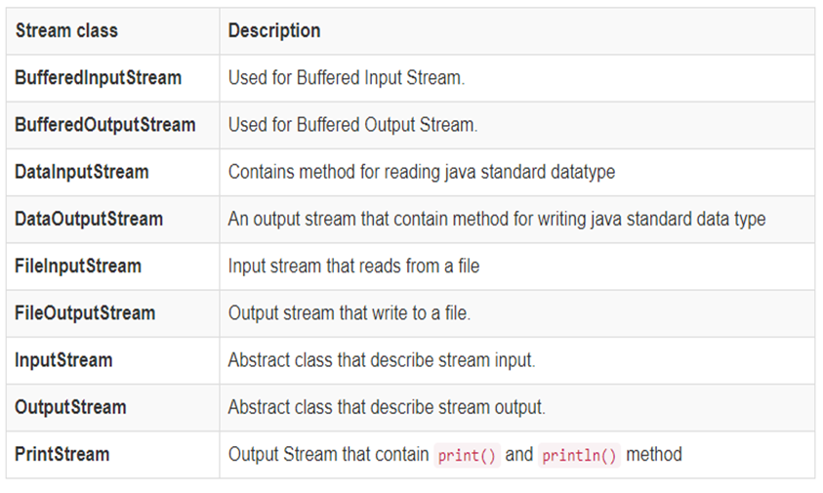
Input & Output Stream subclasses(Byte)

Slide 11
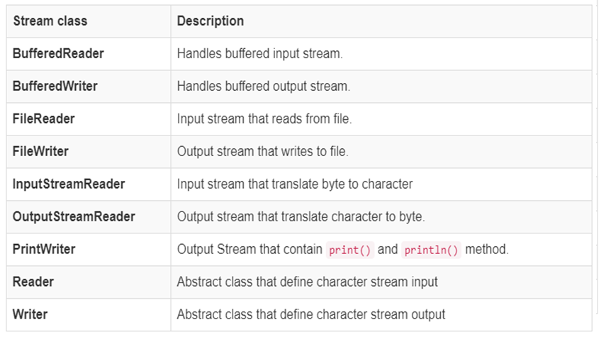
Reader & Writer subclasses (Char)

Slide 12
Java BufferedReader Class
Java BufferedReader class is used to read the text from a character-based input stream.
It internally uses buffer mechanism to make the performance fast.
It inherits Reader class.
This class provides a method : int read() and String readLine()
The BufferedReader reads characters from stream without causing device access every time. So, Read() operations are reduced.

Slide 13

Continued….
Syntax:
InputStreamReader isr = new InputStreamReader (System.in);
BufferedReader br = new BufferedReader (isr);
1010110010
1010110010
1010110010
1010110010
DeviceBuffer
System.in
InputStream Reader
Buffered Reader
KB
Java Application
Example1 : Program to read a character using read() using BufferedReader class
Example2 : Program to take String input from Keyboard using readLine() using BufferedReader class.

Slide 14
command-line arguments
The command-line arguments in Java allow the programmers to pass the arguments during the execution of a program.
A command-line argument is the information that we pass after typing the name of the Java program during the program execution.
These arguments get stored as Strings in a String array that is passed to the main() function.
Internally, JVM wraps up these command-line arguments into the args[ ] array that we pass into the main() function. We can check these arguments using args.length method.
JVM stores the first command-line argument at args[0], the second at args[1], third at args[2], and so on.
Example1 , Example2

